Slide 1
More About Metadata!
Digital Humanities

Slide 2
Metacrap!
In his oft-quoted diatribe, "Metacrap: Putting the Torch to the Seven Straw-men of the Meta-Utopia," journalist, blogger, and science fiction writer Cory Doctorow enumerates what he describes as the "seven insurmountable obstacles between the world as we know it and meta-utopia."
In this piece, Doctorow, a great proponent of making digital content as widely available as possible, puts forth his arguments for the thesis that metadata created by humans will never have widespread utility as an aid to resource discovery on the Web. These arguments are paraphrased as follows.

Slide 3
"People lie."
Metadata on the Web cannot be trusted, because there are many unscrupulous Web content creators that publish misleading or dishonest metadata in order to draw additional traffic to their sites.

Slide 4
"People are lazy."
Most Web content publishers are not sufficiently motivated to do the labor involved in carefully cataloging the content that they publish.

Slide 5
"People are stupid."
Most Web content publishers are not smart enough to catalog effectively the content that they publish.

Slide 6
"Mission: Impossible -know thyself."
Metadata on the Web cannot be trusted, because there are many Web content creators who inadvertently publish misleading metadata.

Slide 7
"Schemas aren't neutral."
Classification schemes are subjective.

Slide 8
"Metrics influence results."
Competing metadata standards bodies will never agree.

Slide 9
"There's more than one way to describe something."
Resource description is subjective.

Slide 10
Discussion…
What do you think of Cory Doctorow’s thoughts about metadata?
Is it fair?
Does he go to far?

Slide 11
Lab time!
Lab #1 – Keyword Description
Lab #2 – Observation Description

Slide 12
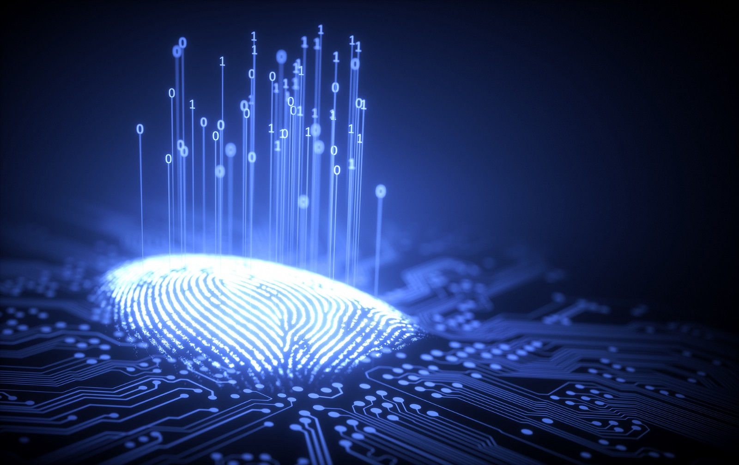
Next class…
Digital Identity and Engagement

